Slide 1

Covid -19 Detection from Xray Images
Submitted by : Group 4
Abhishek Nambiar Chengat (C0849426)
Robin Joshy (C0851926)
Tarun Abraham Rajan (C0850110)
Abiraj Naithalath (C0846455)

Slide 2
Objective:
The outbreak of COVID-19 has posed a global health crisis, and timely detection of the disease is crucial for effective management and containment.
X-ray imaging has emerged as a valuable diagnostic tool for COVID-19 detection due to its accessibility and rapid results. In recent years, neural networks, a subset of deep learning algorithms, have shown remarkable success in image analysis tasks.
In this project, we aim to leverage the power of neural networks to develop a system for COVID-19 detection from X-ray images. By training and fine-tuning neural networks on a diverse dataset of X-ray images, we aim to create an accurate and reliable tool for early detection of COVID-19.

Slide 3
Convolutional Neural Network
CNNs are a type of neural network that are commonly used for image and video recognition tasks, but can also be applied to other types of data such as audio and text.
Convolutional layers apply a set of learnable filters to an input image to extract features such as edges, corners, and other patterns.
CNNs are trained using a dataset of labeled examples, where the network learns to recognize patterns in the data and make predictions based on those patterns.

Slide 4
About Dataset:
For this project, we obtained our dataset of X-ray images for COVID-19 detection from Kaggle.
The first dataset titled "COVID-19 Chest X-Ray Image Dataset" (https://www.kaggle.com/datasets/alifrahman/covid19-chest-xray-image-dataset) contains a diverse collection of chest X-ray images, including COVID-19-positive cases and negative cases.
The second dataset, "COVID-19 X-Ray Dataset (Train/Test sets)" (https://www.kaggle.com/datasets/khoongweihao/covid19-xray-dataset-train-test-sets) provides additional data for training and evaluation. By utilizing both datasets, we aim to enhance the accuracy and reliability of our COVID-19 detection system.

Slide 5
Data Augmentation
Data augmentation involves generating new data from existing data, typically used to enhance the performance of deep learning neural networks by increasing the amount of available data. In this particular case, the dataset was small, which prompted the utilization of data augmentation techniques.

Slide 6
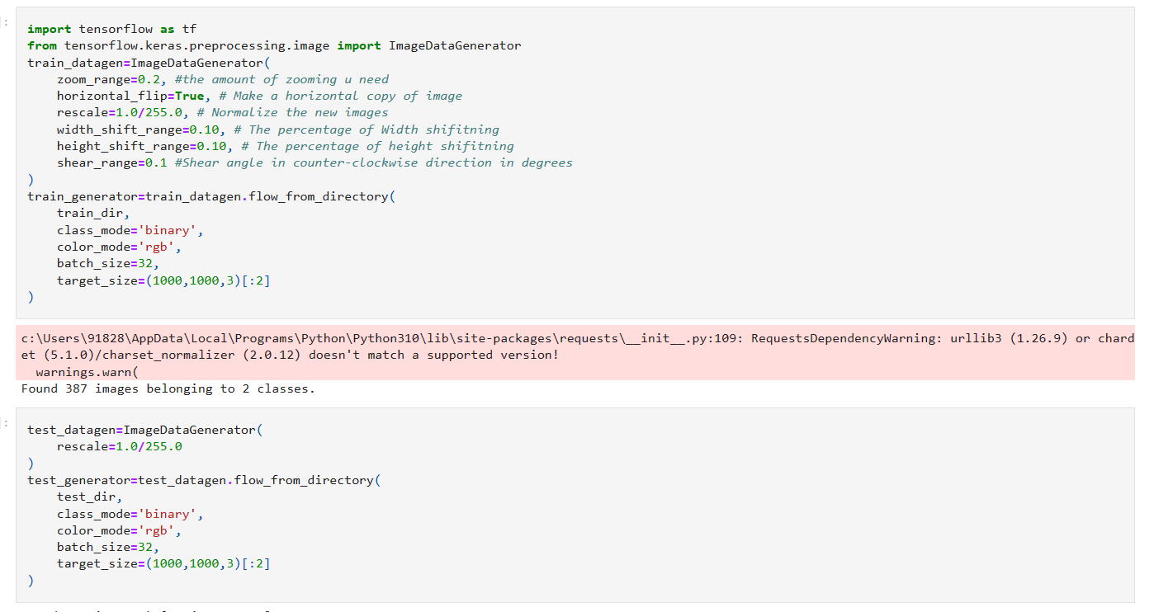

Slide 7
Callbacks
Callbacks are utilized as a method to mitigate overfitting and optimize training time in machine learning models.
For instance, EarlyStopping can be employed to halt the training process if the accuracy fails to improve for a predetermined number of consecutive epochs (here we are setting it to 5 epochs).
Similarly, ReduceLROnPlateau can be utilized to minimize the learning rate if the accuracy does not improve for a set number of epochs (here we are setting it to 2 epochs).

Slide 8
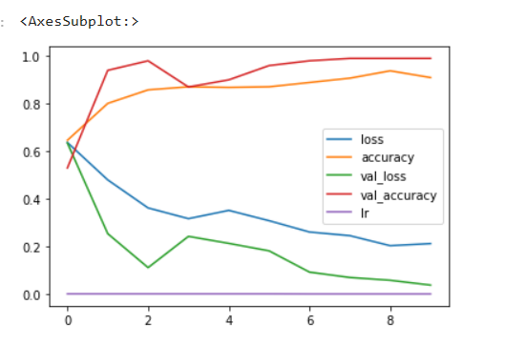
Evaluating the model

Slide 9
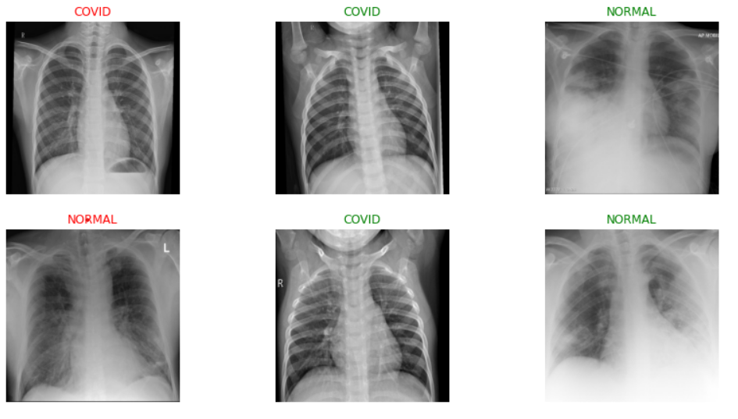
Prediction Results

